Slide 1
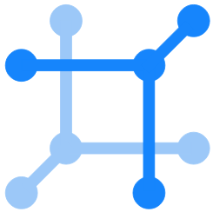
NetBox Day
Opening Remarks
May 19, 2020
Jason Edelman
Founder, Network to Code
jason@networktocode.com

Slide 2

NetBox Day Presented by Network to Code
First ever NetBox Day!
Over 1000 registrants!
Thank you to the community!
Join the conversation on NTC Slack
slack.networktocode.com #netbox

Slide 3
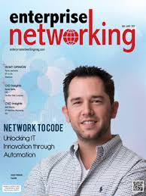
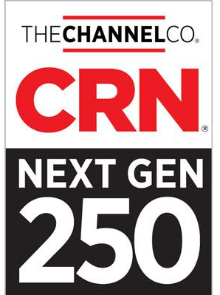

About Network to Code
Network Automation Solution Provider founded in 2014
Bridge the gap between DevOps, Software Development, and Networking
Transform how networks are operated
Notes:
https://blogs.gartner.com/andrew-lerner/2020/04/20/cool-networking-vendors-2020/

Slide 4
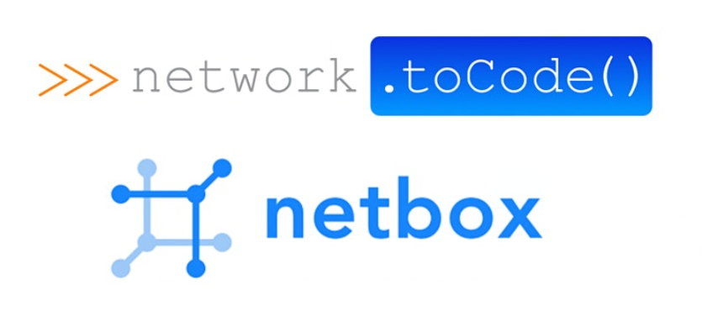
Key Component in Network Automation Solutions
Commercial Support

Slide 5


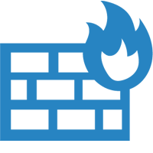



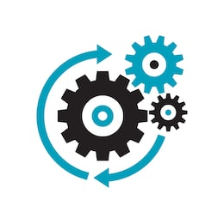
Network Automation Solutions What NTC Builds
Routers
Switches
Presentation Layer
ITSM | ChatOps | IT Ops | Portals
Firewalls
4
Integrations
WLAN
Integrations
4
1
Holistic Strategy & Architecture
SD-WAN
2
Network Automation Platform
Load Balancers
SoT | Telemetry | Automation | Orchestration
5
Any Device
3
Automated Workflows
Delivery
Pipelines
Any Domain
Any Location
Any Controller

Slide 6
Closed-Loop Network Automation Platform
Intended State
Actual State
Orchestration
Execution
Telemetry
Network Infrastructure
Closed-Loop
Continuous Verification

Slide 8
About Network to Code
Network Automation Solution Provider founded in 2014
Bridge the gap between DevOps, Software Development, and Networking
Transform how networks are operated
Key Component in Network Automation Solutions
Commercial Support
Notes:
https://blogs.gartner.com/andrew-lerner/2020/04/20/cool-networking-vendors-2020/

